Slide 1

Security Assessment and Risk Management
Week 2 – Risk Assessments

Slide 2
Risk Motivates
Esteem/
Respect
Humiliation
Pursuit of Comfort
Avoidance of Discomfort
More Freedom
Increased Profits
Less Freedom
Loss of Viability
Acceptance
Value
Rejection
Bankruptcy
Security
Fear

Slide 3
Why Do a Thing?
Sometimes we do something that makes us uncomfortable, because…
there’s a chance we will gain more comfort.
there’s a chance we will eliminate a source of discomfort.
Each decision is a gamble. We give something up for an opportunity of a pay off.
This decision-making process involves evaluating the transaction cost of the deed.

Slide 4
 | WATERING HOLE | DIG WELL | WAIT FOR RAIN
TIME | -1 | -3 | 0
WATER | +1 | +3, 0 | +3, 0
STORED | 0 | 100, 0 | 0
DANGER | 30/70 | 05/95 | 0/0

Slide 5
SP 800-37 / SP 800-53A
Continuous Monitoring
Starting Point
FIPS 200 / SP 800-53
CSC Control Tailoring
FIPS 199
MONITOR
Security Controls
CATEGORIZE Information System
SELECT Security Controls
Continuously track changes to the information system that may affect security controls and reassess control effectiveness
Define criticality /sensitivity of information system according to potential impact of loss
Select baseline (minimum) security controls to protect the information system; apply tailoring guidance as appropriate
SP 800-37
Risk Management
SP 800-53 / SP 800-30
Security Center Analysis
AUTHORIZE Information System
SUPPLEMENT Security Controls
Determine risk to agency operations, agency assets, or individuals and, if acceptable, authorize information system operation
Use risk assessment results to supplement the tailored security control baseline as needed to ensure adequate security and due diligence
SP 800-53A
Control Effectiveness Audit
SP 800-17
System Security Plan (SSP)
SP 800-70
CSC Controls Roll out
ASSESS
Security Controls
DOCUMENT Security Controls
IMPLEMENT Security Controls
Determine security control effectiveness (i.e., controls implemented correctly, operating as intended, meeting security requirements)
Document in the security plan, the security requirements for the information system and the security controls planned or in place
Implement security controls; apply security configuration settings

Slide 6
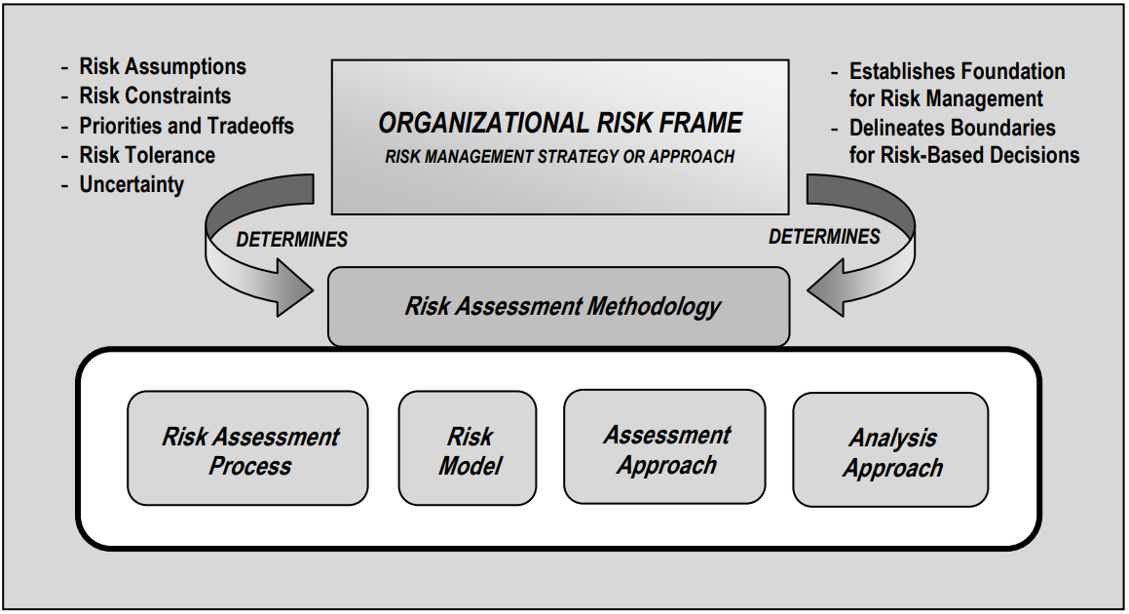
Notes:
A risk assessment methodology typically includes:
a risk assessment process (as described in Chapter Three);
an explicit risk model, defining key terms and assessable risk factors and the relationships among the factors;
an assessment approach (e.g., quantitative, qualitative, or semi-qualitative), specifying the range of values those risk factors can assume during the risk assessment and how combinations of risk factors are identified/analyzed so that values of those factors can be functionally combined to evaluate risk; and
an analysis approach (e.g., threatoriented, asset/impact-oriented, or vulnerability-oriented), describing how combinations of risk factors are identified/analyzed to ensure adequate coverage of the problem space at a consistent level of detail.

Slide 7
Qualitative & Quantitative Assessment
There are two main types of risk assessments: Qualitative and quantitative.
Quantitative assessments COUNT (quantity) – Prescribing a number to an event, asset, or incident. This could be total sum, value, etc.
Qualitative assessments DESCRIBE (qualify) – Identifying the events, assets, or incidents. This could be data categories, systems, processes, etc.
A qualitative assessment will determine characteristics, usually used to create groups for ease of discussion or management.
A quantitative assessment is useful for directing decisions and placing assets.

Slide 8
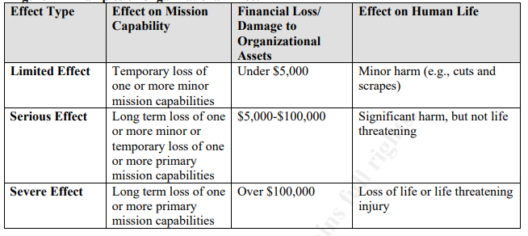
Qualitative Assessments
Qualitative assessments assume a great degree of uncertainty.
A qualitative assessment is generally subjective in nature.
A general rule of thumb so everyone is on the same page is to chunk high/moderate/low in percentiles.
Another way to do this assessment is on the CIA triad.

Slide 9
Semi-Quantitative
Typically employ a set of methods, principles, or rules for assessing risk that uses bins, scales, or representative numbers whose values and meanings are not maintained in other contexts.
The bins (e.g., 0-15, 16-35, 36-70, 71-85, 86-100) or scales (e.g., 1-10) translate easily into qualitative terms that support risk communications for decision makers (e.g., a score of 95 can be interpreted as very high), while also allowing relative comparisons between values in different bins or even within the same bin (e.g., the difference between risks scored 70 and 71 respectively is relatively insignificant, while the difference between risks scored 36 and 70 is relatively significant).

Slide 10
Business Value
Identify the workflows that generate the greatest business value and define their associated risks.
It is important to consider the potential impact of crucial workflows because these can also pose a significant risk.
For example, payment processes create value but present a business risk, as they are vulnerable to fraud and data leakage.

Slide 11
 | LIMITED | SERIOUS | CRITICAL
C | X
I | X
A |  | X
System includes data with low confidentiality.
System requires low data integrity.
System requires moderate availability.
System Risk Categorization
Moderate

Slide 12
Prioritizing Risks
Determine risk level based on the cost of prevention and value of information to inform your risk management and mitigation procedures.
High-level risks should be addressed as soon as possible, while low-level risks can be addressed down the line or accepted as a tolerated risks.
If the cost of protecting an asset is higher than its value, the expense is not worthwhile unless the risk may impact your reputation.

Slide 13
Quantitative Assessment
Risk management is a big part of the CISSP exam. There are calculations you are expected to perform to assess risk.
ALE – Annualized Loss Expectancy. The ALE is calculated by multiplying the SLE (Single Loss Expectancy) and ARO (Annualized Rate of Occurrence.)
SLE – The value of a single loss of the asset.
ARO – How often the loss occurs, or the likelihood.

Slide 14
Quantitative Assessment
So, if we have an asset, our DC, for $6 million dollars. The odds of a tornado hitting the DC in any given year is roughly 50/50. Our ALE is $3m dollars. Now, that’s an absolutely insane figure because having a DC in an area that has a 50/50 shot of getting hit by a tornado is ludicrous.
This type of assessment is common in insurance and finances, but it’s not usually the most reliable for information systems, because the value of an asset is much harder to estimate.

Slide 15
Likelihood
The likelihood risk factor combines an estimate of the likelihood that the threat event will be initiated
with an estimate of the likelihood of impact.
For adversarial threats, an assessment of likelihood of occurrence is typically based on:
(i) adversary intent;
(ii) adversary capability; and
(iii) adversary targeting.
For other than adversarial threat events, the likelihood of occurrence is estimated using historical evidence, empirical data, or other factors. Note that the likelihood that a threat event will be initiated or will occur is assessed with respect to a specific time frame (e.g., the next six months, the next year, or the period until a specified milestone is reached).

Slide 16
You try:
Determine the likelihood that:
Portage County, Wisconsin has had 70 Tornados since 1950. What is the probability the County will have another tornado next year?
There have been 24 tornados within 25 miles of UWSP since 1950. What are the odds there will be a tornado within 25 miles of campus within a year?
The data center has a SLE of $6 million. What is the ALE in this case?
There has been 1 F4 tornado in Portage County, WI and within 25 miles of UWSP since 1950. Would an investment in tornado protection for the data center make sense if it guaranteed protection for up to F4 tornados, and cost $6 million?

Slide 17
What is a Security Framework?
Security Control | Family ID | Low | Medium | High | Total
Access Control | AC | 11 | 34 | 41 | 110
Awareness and Training | AT | 4 | 5 | 5 | 10
Audit and Accountability | AU | 10 | 18 | 27 | 56
Security Assessment and Authorization | CA | 7 | 10 | 12 | 22
Configuration Management | CM | 8 | 21 | 31 | 50
Contingency Planning | CP | 6 | 22 | 35 | 48
Identification and Authentication | IA | 15 | 23 | 25 | 56
Incident Response | IR | 7 | 12 | 16 | 34
Maintenance | MA | 4 | 9 | 13 | 26

Slide 18
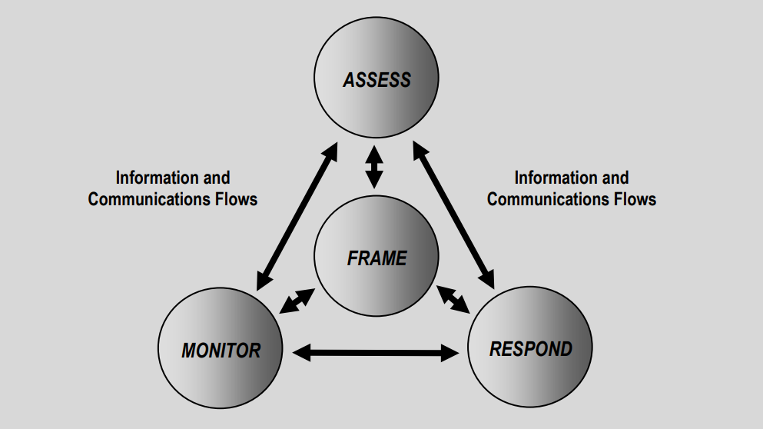

Slide 19
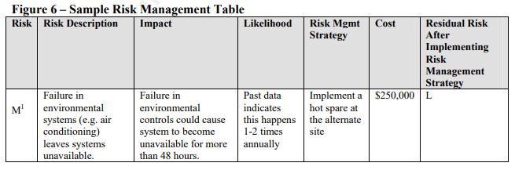
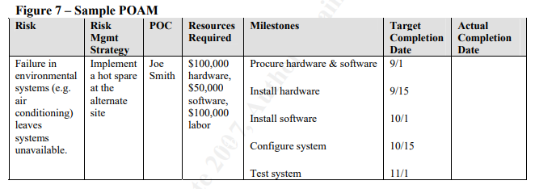

Slide 20
How is Risk Managed?
NIST 800-30 includes a risk assessment and methodology framework. The methodology contains nine steps:
Step 1: System Characterization
Step 2: Threat Identification
Step 3: Vulnerability Identification
Step 4: Control Analysis
Step 5: Likelihood Determination
Step 6: Impact Analysis
Step 7: Risk Determination
Step 8: Control Recommendations
Step 9: Results Documentation

Slide 21
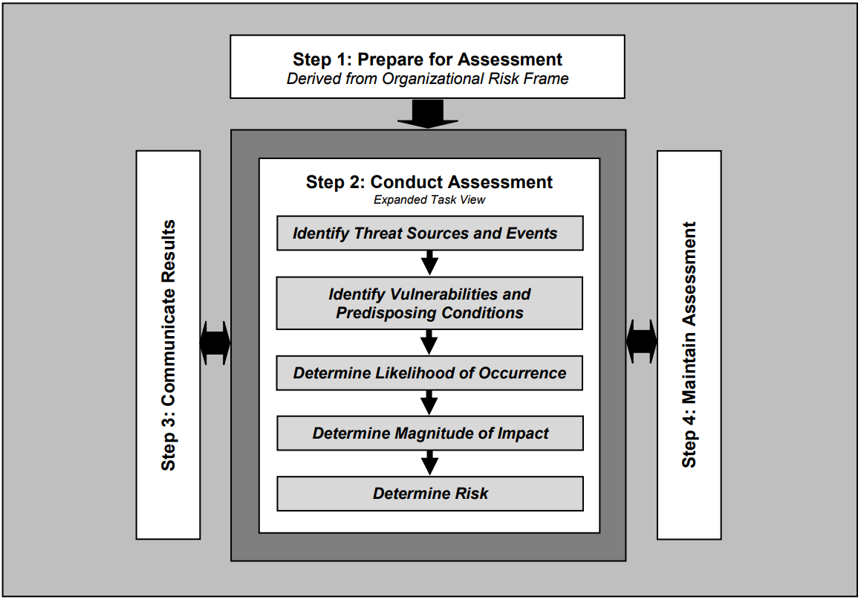

Slide 22
Assessment Methodology
Analysis approaches differ with respect to the orientation or starting point of the risk assessment, level of detail in the assessment, and how risks due to similar threat scenarios are treated. An analysis approach can be:
(i) threat-oriented;
(ii) asset/impact-oriented; or
(iii) vulnerability oriented.

Slide 23
Assessment Methodology
A threat-oriented approach starts with the identification of threat sources and threat events, and focuses on the development of threat scenarios;
Vulnerabilities are identified in the context of threats, and for adversarial threats, impacts are identified based on adversary intent.

Slide 24
Assessment Methodology
An asset/impact-oriented approach starts with the identification of impacts or consequences of concern and critical assets, possibly using the results of a mission or business impact analyses and identifying threat events that could lead to and/or threat sources that could seek those impacts or consequences.

Slide 25
Assessment Methodology
A vulnerability-oriented approach starts with a set of predisposing conditions or exploitable weaknesses/deficiencies in organizational information systems or the environments in which the systems operate, and identifies threat events that could exercise those vulnerabilities together with possible consequences of vulnerabilities being exercised.

Slide 26
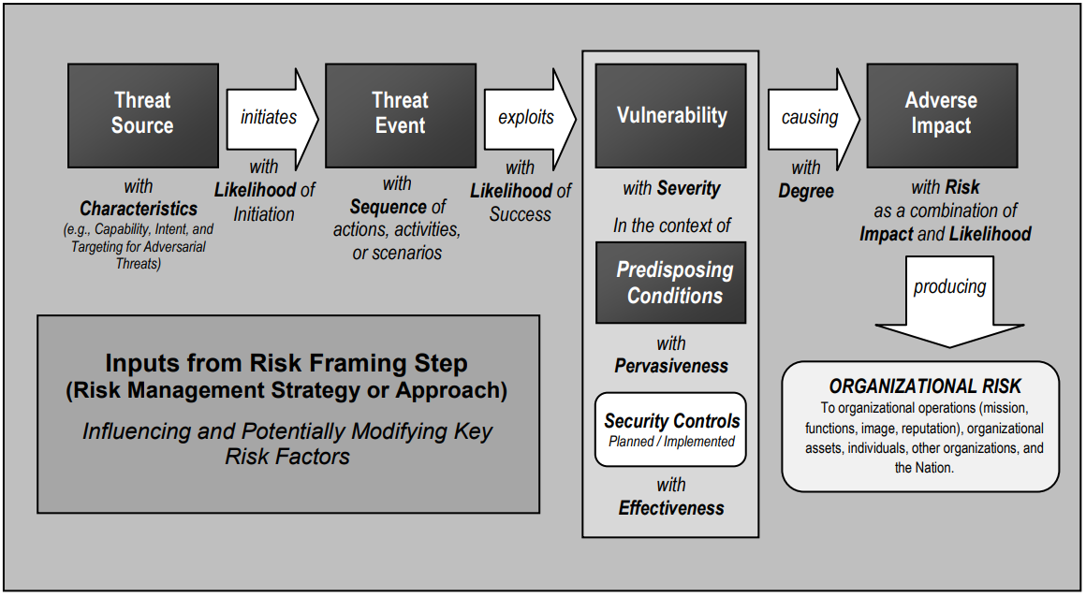

Slide 27
Risk Registry
I hope this has become abundantly clear, but I’ll reiterate – you can’t remediate every threat.
A big part of risk management and reading the threat landscape is intelligence – knowing your blind spots, recording vulnerabilities, categorizing them, and reviewing them regularly to determine if they become actionable at a later date.
You do this with a risk registry. Simply, a document where you record your known issues and establish a procedure for triage and following up on them.

Slide 28
Risk Registry
Date Added | Date for Review | Description | Risk Owner | Risk Trigger | Risk Category
Date Added to the Register | Date for Review | Description of the risk | Name of person who monitors the risk | How you know the risk is becoming an issue or has reached a point that requires action. | Group defines the types of risks (technology, financial, staffing, etc.)
Response Trigger | Response Owner | Response Description | Expected Impact of Response
How do you know it is time to put the response into play | Who is responsible for initiating the response | What is the response | What do you expect will result from the response
PI Score | Change | Expected Result, No Action | Risk Response Type
Probability multiplied by Impact | Increase / Decrease from last review | What will happen if the risk becomes an issue and no action is taken | Decision made by group on how to respond to this risk (see above in blue)

Slide 29
Probability and Impact
Probability
Group sourced rough estimate of how likely this is to occur. 1 - Unlikely, but possible 2 - Probable / Likely 3 - Near certainly or very likely
Impact
Group sourced rough estimate of how significant the impact of this risk will be if/when it becomes an issue 1 - Low impact / Non-critical 2 - Moderate impact / Impairs future planning 3 - High impact / cripples daily operations

Slide 30
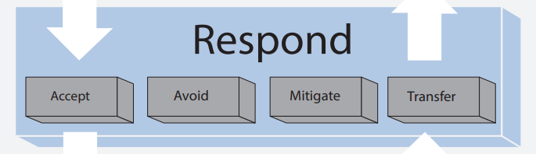
How is Risk Managed?
When a risk is identified, you need to come up with a plan on how to deal with it. This is known as the Plan of Action (alternatively, Plan of Action & Milestones) POA/POAM.
Notes:
Accept: This just means allowing the system to operate with known risks. That doesn’t mean ignore them. That doesn’t mean when there’s a breach you say, “Oh yeah we knew about that. I have an email from the CEO that said it’s ok.” There’s still a formal process to accepting risk. Sometimes, your response to risk is “monitor it for a year, revisit and reevaluate.” That is a valid tact in some cases. It should obviously be used sparingly.
Avoid: Just get rid of the system causing risk. Either don’t use it at all anymore, upgrade to a less-risky version, replace it with a less-risky competitor, or completely abandon the business process that relies on it. In that last case, let’s say the company is a mail-order business. The phone system was implemented in the 90s and the website launched in 2003. Since the Internet, phone sales have dropped off. If a vulnerability in the phone system would take $250,000 to mitigate, and phone sales have dropped off to $10,000 a year, it might be worth thinking about closing the call center for good and moving those employees over to by-chat customer service agents.
Mitigate: Fix the flaw or introduce a compensating control to reduce the impact.
Transfer: Offload the risk to another party. Insurance is a way to transfer risk. This also includes outsourcing risky services. There is such a thing as ISRI – Information Security Risk Insurance which covers the financial loss of data, but does nothing for reputation.

Slide 31
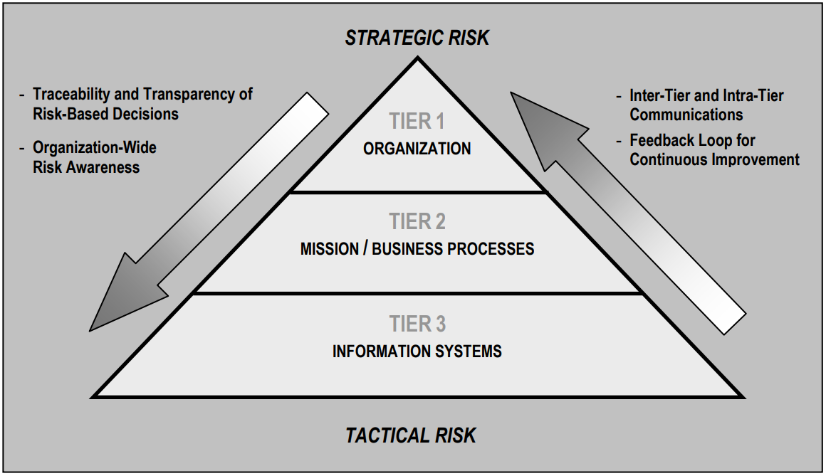
Notes:
Risk assessments support risk response decisions at the different tiers of the risk management hierarchy.
At Tier 1, risk assessments can affect, for example:
organization-wide information security programs, policies, procedures, and guidance;
the types of appropriate risk responses (i.e., risk acceptance, avoidance, mitigation, sharing, or transfer);
investment decisions for information technologies/systems;
procurements;
minimum organization-wide security controls;
conformance to enterprise/security architectures; and
monitoring strategies and ongoing authorizations of information systems and common controls.
At Tier 2, risk assessments can affect, for example:
enterprise architecture/security architecture design decisions;
The selection of common controls;
the selection of suppliers, services, and contractors to support organizational missions/business functions;
the development of risk-aware mission/business processes; and
the interpretation of information security policies with respect to organizational information systems and environments in which those systems operate.
Finally, at Tier 3, risk assessments can affect, for example:
design decisions (including the selection, tailoring, and supplementation of security controls and the selection of information technology products for organizational information systems);
implementation decisions (including whether specific information technology products or product configurations meet security control requirements);
operational decisions (including the requisite level of monitoring activity, the frequency of ongoing information system authorizations, and system maintenance decisions).

Slide 32
Preparing for an Assessment
Identify the purpose of the assessment;
Identify the scope of the assessment;
Identify the assumptions and constraints associated with the assessment;
Identify the sources of information to be used as inputs to the assessment; and
Identify the risk model and analytic approaches (i.e., assessment and analysis approaches) to be employed during the assessment.

Slide 33
Risk Models
Risk models define the risk factors to be assessed and the relationships among those factors.
Risk factors are characteristics used in risk models as inputs to determining levels of risk in risk assessments.
Typical risk factors include threat, vulnerability, impact, likelihood, and predisposing condition.
Risk factors can be decomposed into more detailed characteristics (e.g., threats decomposed into threat sources and threat events).
Notes:
Risk factors are also used extensively in risk communications to highlight what strongly affects the levels of risk in particular situations, circumstances, or contexts.
These definitions are important for organizations to document prior to conducting risk assessments because the assessments rely upon well-defined attributes of threats, vulnerabilities, impact, and other risk factors to effectively determine risk.

Slide 34
Threat Sources
A threat source is characterized as:
the intent and method targeted at the exploitation of a vulnerability; or
a situation and method that may accidentally exploit a vulnerability.
In general, types of threat sources include:
hostile cyber or physical attacks;
human errors of omission or commission;
Structural failures of organization-controlled resources (e.g., hardware, software, environmental controls);
natural and man-made disasters, accidents, and failures beyond the control of the organization.

Slide 35
Threat Shifting
Threat shifting is the response of adversaries to perceived safeguards and/or countermeasures (i.e., security controls), in which adversaries change some characteristic of their intent/targeting in order to avoid and/or overcome those safeguards/countermeasures. Threat shifting can occur in one or more domains including:
the time domain (e.g., a delay in an attack or illegal entry to conduct additional surveillance);
the target domain (e.g., selecting a different target that is not as well protected);
the resource domain (e.g., adding resources to the attack in order to reduce uncertainty or overcome safeguards and/or countermeasures); or (iv) the attack planning/attack method domain (e.g., changing the attack weapon or attack path).
Threat shifting is a natural consequence of a dynamic set of interactions between threat sources and types of organizational assets targeted

Slide 36
Predisposing Conditions
A predisposing condition is a vulnerability that exists within an organization, a mission or business process, enterprise architecture, information system, or environment of operation, which affects (i.e., increases or decreases) the likelihood that threat events, once initiated, result in adverse impacts to organizational operations and assets, individuals, other organizations, or the Nation.
Predisposing conditions include, for example, the location of a facility in a hurricane- or flood-prone region.

Slide 37
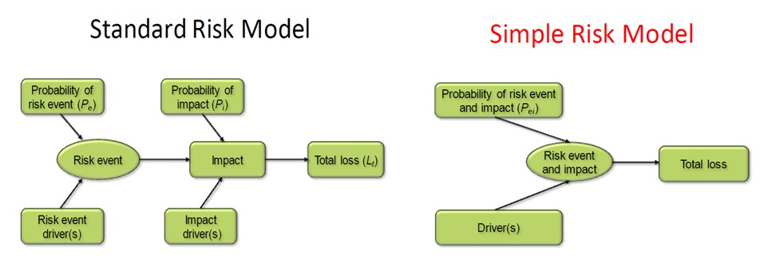
Risk Models

Slide 38
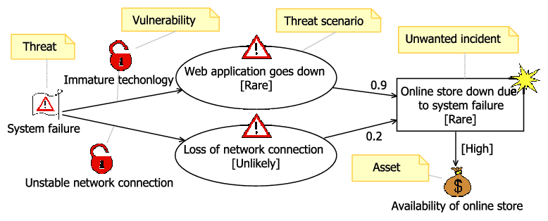
Risk Models

Slide 39
Threat modeling
In a large organization, risk can be difficult to see. In no time at all an environment can become extremely complicated, and the necessity of having a lot of IT employees and the realities of business (employee turn-over, etc.) means very soon you will have no idea what is happening anywhere.
Threat modeling is a process by which potential threats, such as structural vulnerabilities can be identified, enumerated, and prioritized – all from a hypothetical attacker’s point of view. The purpose of threat modeling is to provide defenders with a systematic analysis of the probable attacker’s profile, the most likely attack vectors, and the assets most desired by an attacker. Threat modeling answers the questions “Where are the high-value assets?” “Where am I most vulnerable to attack?” “What are the most relevant threats?” “Is there an attack vector that might go unnoticed?”

Slide 40
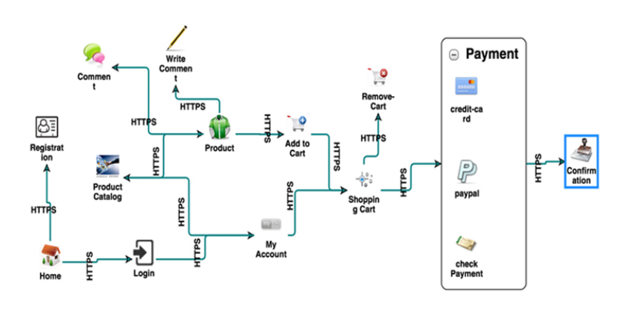
Threat modeling
There are a lot of different methodologies out there, but virtually all of them rely on visual representations, such as data flow or process flow charts.

Slide 41
Threat modeling
The one we’ll talk a bit about is called P.A.S.T.A – Process for Attack Simulation & Threat Analysis. It has seven objectives in the threat modeling cycle.
Define business objectives – You have a process before you. Why does the business need to do this?
Define technical scope – What systems/assets will be included in this assessment?
Application decomposition – What application controls are available to protect this process?
Threat analysis – What threats currently exist to threaten this process?
Vulnerability detection – What risks are carried by this process?
Attack enumeration – Using the above information, what are available vectors?
Risk/impact analysis – What are your possible outcomes? What countermeasures need to be developed?

